Slide 1
FUNCTIONS AND GRAPHS (EXPONENTIALS)
Prepared by :
Nurul Fariha
Siti Hawa

Slide 2
The number e
The letter e is the initial of the last name of Leonhard Euler (1701-1783)
who introduced the notation.
Since f(x) = e^{x} has special calculus properties that simplify many
calculations, it is the natural base of exponential functions.
The value of e is defined as the number that the expression ( 1 + 1/n ) ^{n}
approaches as n approaches infinity.
The value of e to 16 decimal places is 2.7182818284590452.
The function f(x) = e^{x} is called the Natural Exponential Function

Slide 3
To find the value of e, take the expression ( 1 +1/n ) ^{n} and evaluate it for increasing values of n
Substitute n = 1, 2, 3, 5, 10, 100 ... into the expression
As n increases, ( 1 +1/n ) ^{n} becomes closer and closer to 2.718281828 ....
n | ( 1 +1/n ) ^{n}
1 | 2
10 | 2.59374
100 | 2.70481
1 000 | 2.71692
10 000 | 2.71815
1 00 000 | 2.71827
1 000 000 | 2.71828

Slide 4

a is fixed. Investigate what happen to the limiting behaviour as n→∞
let a = 2
therefore , ( 1 +2/n ) ^{n}
n | ( 1 +2/n ) ^{n}
1 | 3
10 | 6.191736
100 | 7.244646
1 000 | 7.374312
10 000 | 7.387579
1 00 000 | 7.388908
1 000 000 | 7.389041

Slide 5
Graph of y = e^{x}
Calculate the value of y by substituting the value of x
x | f(x)
-3 | 0.04979
-2 | 0.13534
-1 | 0.36788
0 | 1
1 | 2.71828
2 | 7.38906
3 | 20.08553
4 | 54.59815
5 | 148.41316

Slide 6
Graph of e

Slide 7
The general exponential functions
The general form can be expressed as:
Vertical stretch/compression
Reflection about x-axis if negative
Vertical shift
Horizontal shift
Horizontal stretch or compression
Reflection about y-axis if negative

Slide 8
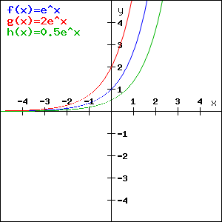
Dilation in the y direction (a)
a is a dilation (stretched or compressed) in the y-direction.
For 0 < |a| < 1the graph will be compressed
For |a| > 1 it will stretch.
If a < 0 then the graph will dilate and be reflected in the x-axis.
g(x) = 2e^x
f(x)=e^x
h(x) = 0.5e^x
Exponential function with positive y-dilation

Slide 9
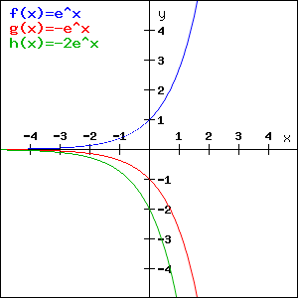
f (x) = e^x
g (x) = -e^x
h (x) = -2e^x
Exponential function with negative y dilation

Slide 10
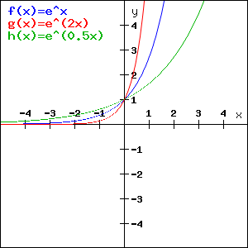
Dilation in the x direction (b)
b is a dilation (stretched or compressed) in the x-direction.
For 0 < |b| < 1 the graph will be compressed.
For |b| >1 it will stretch.
If b < 0 then the graph will dilate and be reflected in the y-axis.
f (x) = e^x
g (x) = e^ (2x)
h (x) = e^(0.5x)
Exponential function with positive x-dilation

Slide 11
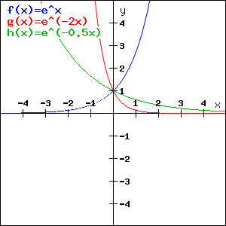
f (x) = e^x
g (x) = e^ (-2x)
h (x) = e^(-0.5x)
Exponential function with negative y-dilation

Slide 12
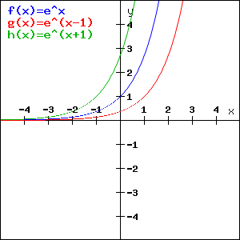
Translation in the x-direction (c)
When c > 0 the entire graph will translate |c| units to the right.
When c < 0 the entire graph will translate |c| units to the left.
f (x) = e^x
g (x) = e^ (x-1)
h (x) = e^(x+1)
Translation in the x direction

Slide 13
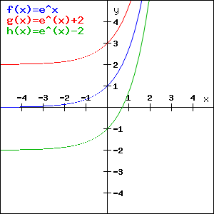
Translation in the y-direction (d)
When d > 0 the entire graph will translate |d| units up.
When d < 0 the entire graph will translate |d| units down.
f (x) = e^x
g (x) = e^ (x) +2
h (x) = e^(x) - 2
Translation in the y direction

Slide 14
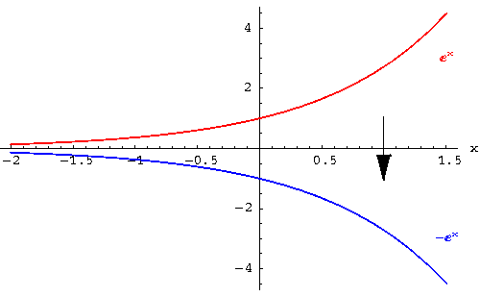
Reflection
Reflection across the x - axis

Slide 15
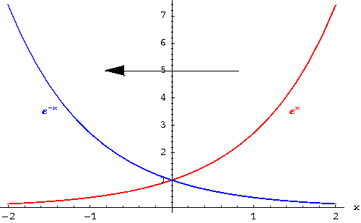
Reflection across y - axis

Slide 16
examples
Sketch the graph of the followings:
(a) f(x) = -3e^{x} + 2
(b) f(x) = 2e^{x-1}
(c) f(x) = 2e^{-x} + 1

Slide 17
Example (a)
x
f(x) = -3e^{x} + 2

Slide 18
Example (b)
f(x) = 2e^{x-1}
x

Slide 19
Example (c)
f(x) = 2e^{-x} + 1
x

Slide 20
Summary
y = af [b(x – c] + d
Horizontal dilation or reflection on y-axis
Translation horizontally
Vertical dilation or Reflection on x-axis
translation vertically

Slide 21
References
http://www.craigsmaths.com/number/graphs-of-exponential-functions/
http://www.analyzemath.com/Graphing/GraphExponentialFunction.html
http://www.mathsisfun.com/exponent.html
http://www.thestudentroom.co.uk/wiki/Revision:OCR_Core_1_-_Transforming_graphs
Applicable Mathematics Graphics Calculator Edition by Ellery and Strickland

